Slide 1
Cardinal newman’s VE DAY 75TH ANNIVERSARY celebrations

Slide 2
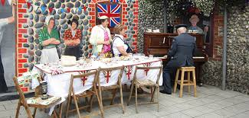
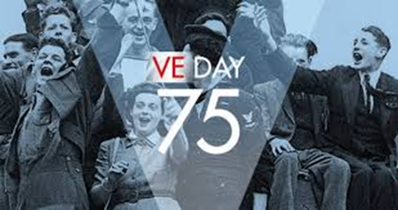
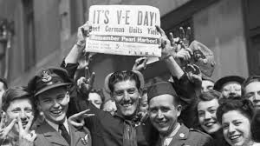
What Was VE Day?
The Second World War ended on 8th May1945 in Europe when the German Army signed the armistice, surrendering to the allies. Britain had fought for six long years and suffered tremendously due to enemy bombing, rationing, loss of soldiers and the effects of the second total war.
When the war was over, the people of Britain were overjoyed. They gathered at Buckingham Palace to see the King and listened to his speech around the wireless in their homes.
WHAT ELSE CAN YOU FIND OUT ABOUT VE DAY?
Street parties were held to celebrate VE day with food and games. Even Princess Elizabeth and Princess Margaret went into town to party. Even though the war continued in the East against Japan, it was certain to be over soon. held, as were all-night celebrations. Even Princess Elizabeth and Princess Margaret went out into town to party! Even though the war continued in the East against Japan, it was certain Eating for victory – try these real wartime ration recipes for VE be over soon.

Slide 3
This Year We Are Celebrating the 75th Anniversary of VE day
We were planning to have a VE day celebration at school on Thursday May 7th but we are now hoping we can bring these celebrations into your own homes and gardens.
Your task will be to plan a VE day party. Take lots of photos and send your pictures into school.
If lots of people take a picture of their decorated VE table with all the family sharing a special VE day tea, we could join them together and show that although we are not all in school to remember this special anniversary, we can still be ‘together’ even though we are apart.

Slide 4
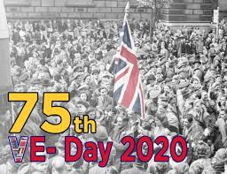
Design a VE Day Party
YOUR TASK:
You need to plan a VE Day Party for your family.
Plan your menu. Remember that most items were rationed during World War 2 but as it was a special occasion making a cake or fairy cakes would have been permitted. Why not research a WW2 recipe?
Plan your decorations using what you can spare at home, paper, flowers, ribbons and paints.
Make flags and bunting for your house or garden.
Dress up for the party – make sure all the family wears red, white and blue.

Slide 5
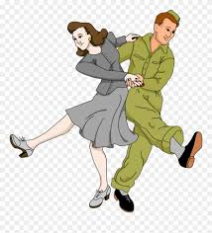
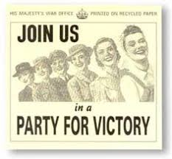
Some ideas for your VE day party
Your VE Party needs to be about more than eating food!
Design invitations / programme of events.
Organise some games/activities
Races – egg and spoon, three-legged and sack races in your house or garden,
Play hunt the thimble or other small object - someone hides an object and everyone else has to find it.
Scavenger hunt - Can you find objects in your house and garden that spell out the words Victory in Europe.
Have a family placemat designing competition.
Play marbles, tiddlywinks or jacks
Music/Dance
Play some WW2 music, try to learn a simple song as a family or have a go at some WW2 dances.
At 3.pm all stop to sing the National Anthem

Slide 6
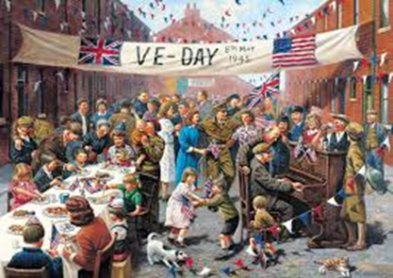
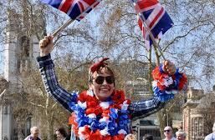
plan your party
When will I send out invitations to my family members?
Draw up a timetable for the day - When will your party start? When will you eat the food? What time will the games start?
What food do I need to prepare?
How will I decorate my table / room?
What activities will I choose?

Slide 7
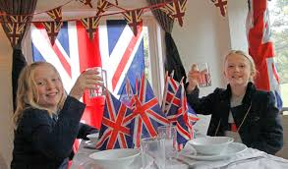
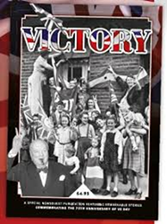
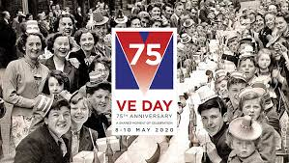
Possible timetable for the Celebration
8.40-10.30 Colour Union Jacks / make bunting / make table decorations/ design place mats / plan games
10.30-10.45 Break play outside if possible
10.45-12.00 Prepare food / bake cakes
12.00 -1.00 Lunch
1.00-2.00 Put up decorations, decorate your table
2.00-2.30 Play a few of the games you have organised
2.30-3.00 Party tea
3.00 Sing the National Anthem together.
3.05-3.30 Play some more games
Don’t forget to clear up after it is all over!
Parents – This is just a possible timetable
It needs to work for you too!

Slide 8
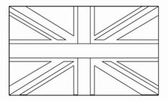
Template for Union Jack

Slide 9
Template for Bunting

Slide 10
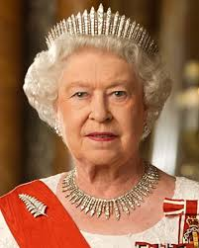
National Anthem
God save our gracious Queen Long live our noble Queen God save the Queen Send her victorious Happy and glorious Long to reign over us God save the Queen
Listen to the National Anthem
Click Here

Slide 11
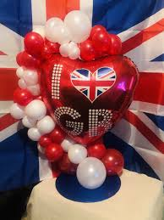
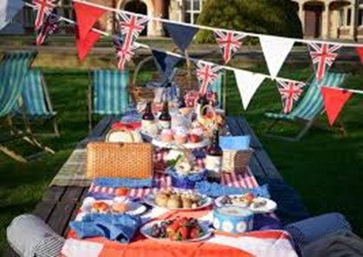
After your party
Consider why VE day was so significant
Put yourself in the shoes of someone living in Britain in 1945:
Why did VE Day mean so much to people?
Why did they celebrate so much?
Would it have been a day of mixed emotions for people who had lost someone in the war?
What if they knew someone who was still fighting in the Far East?
At the end of the day write your thoughts in a diary or create a newspaper front page to explain what happened at your party.

