Slide 1
Year 1
UNIVERSAL CHURCH – WORLD

Slide 2
EXPLORE
Neighbours all around
STANDARD INDICATORS
Children will be able to talk about their experience and feelings about neighbours.
Children will be able to say what they wonder about neighbours, both locally and globally.
Children will be able to ask and respond to questions about their own and others’ experiences and feelings about neighbours.
KEY WORDS
neighbour, love world, CAFOD

Slide 3
LEARNING INTENTION: Recognise that we are all neighbours.
Who are your neighbours?

Slide 4
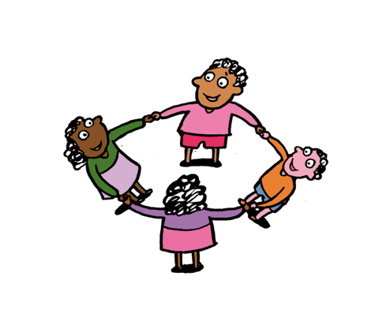
Year 1 Neighbours

Slide 5
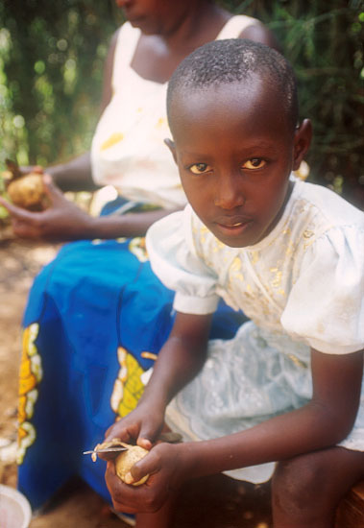
Hi!
My name is
Marie-Doriane.
I am your neighbour.

Slide 6
I am 8.
I live in a village called Gasalo, in Rwanda.
Rwanda is in Africa.
Notes:
Marie-Doriane Uwituze, 8 yrs, daughter of Liberate Muhagihana. Liberate is a mother of 3, looks after 4 orphans and works as a counsellor for AVEGA. AVEGA provides a forum for genocide widows to share their experiences, offer mutual support and find solutions to their problems.

Slide 7
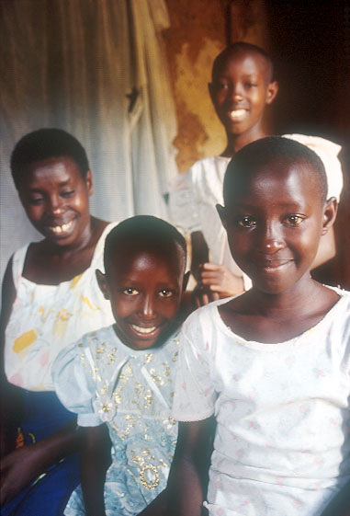
I have a big family!
There are 8 of us!
CAFOD helped us to have our own house.
My dad was killed. It makes me sad to think of him.
Notes:
(Facing LtoR) Liberate Muhagihana, mother of 3 and looks after 4 orphans: Marie-Doriane Uwituze, 8; Marie-Claire Umuhoza, 13 and Marie Louise Uwamahoro, 10.

Slide 8
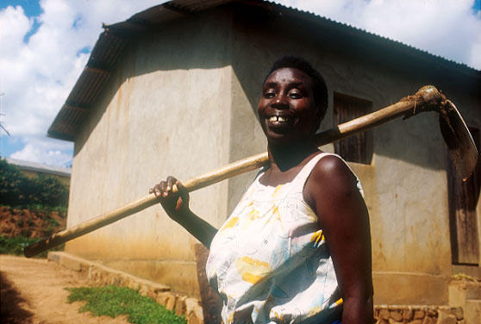
She works really hard in the fields.
She sells the crops she grows to have money to buy food and to pay for me to go to school.
This is my mum
Liberate.
Notes:
Liberate Muhagihana, mother of 3, looks after 4 orphans and grows own crops. She lost a husband and son during the genocide. Liberate has received counselling and now works as a counsellor for AVEGA. AVEGA provides a forum for genocide widows to share their experiences, offer mutual support and find solutions to their problems.

Slide 9
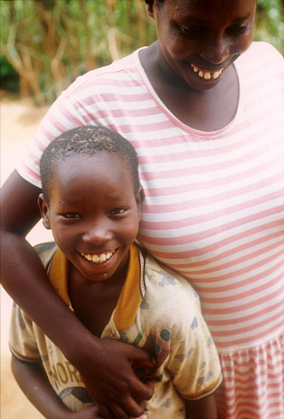
Our mum helps make our home happy.
She shares her love, her time and her care with us all.
We have lots of fun.

Slide 10
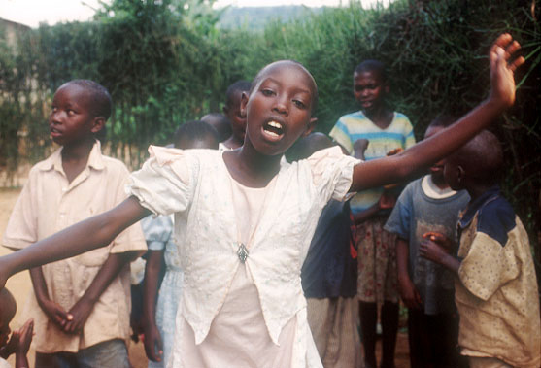
This is
my big sister
Marie-Claire dancing!
She is 13. She helps my mum clean the house.
She loves school.
Notes:
Marie-Claire Umuhoza, 13, daughter of Liberate Muhagihana. She loves school. Her favourite subjects are English, French
and Maths.

Slide 11
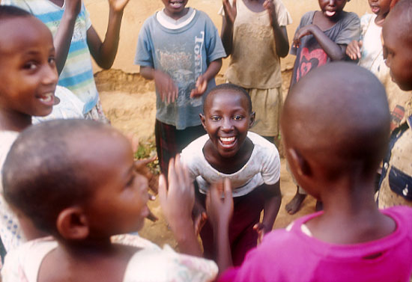
We love to play with our friends.
This is my sister Marie-Louise. She is 10.
She is playing a clapping game.
Do you know any clapping games?
Notes:
Marie Louise Uwamahoro, 10 yrs, daughter and youngest child of Liberate Muhagihana playing clapping game.

Slide 12
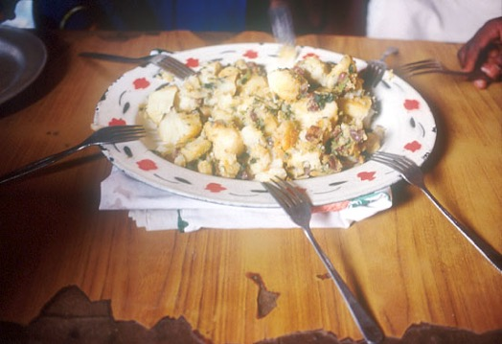
This is our lunch. It is made from onions, tomatoes, potatoes and green vegetables.
Yummy!
What’s your favourite lunch?

Slide 13
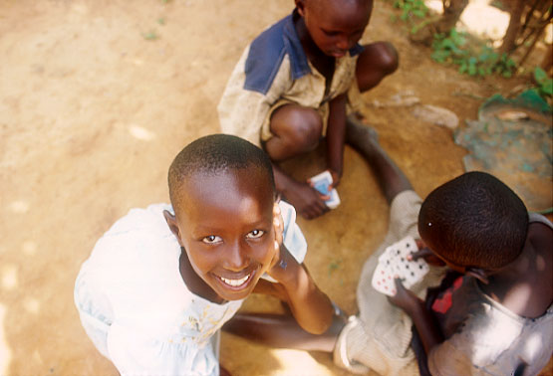
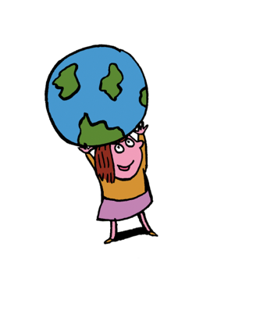
I hope you enjoyed reading my story.
We live far apart but we are neighbours.
We all belong to one world and one family.
Notes:
Marie-Doriane Uwituze, 8 yrs, daughter and youngest child of Liberate Muhagihana playing clapping game.

Slide 14
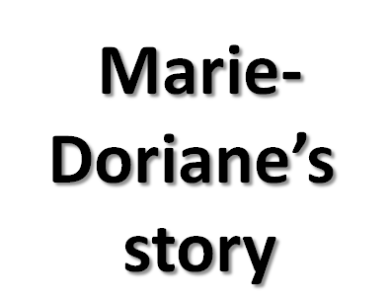
Photographs by: Annie Bungeroth
Illustrations: Per Karlen

Slide 15
SOME KEY QUESTIONS TO TALK ABOUT:
Where does Marie-Dorianne live?
How old is she?
How is Marie-Dorianne like you?
Marie-Dorianne is not your next-door neighbour; she isn’t a neighbour in your class; she isn’t a neighbour in your school. Why do you think Marie-Dorianne is your neighbour?
CAFOD helps our neighbours around the world, particularly those who are poor. How has CAFOD helped Marie-Dorianne’s family?

Slide 16
Show your learning…
Draw a picture of your friend and write about how they are a neighbour to you.
For example:
Daniel is my neighbour because he takes care of me on the playground.
Sophie is my neighbour because she plays with me in the role-play area.

Slide 17
REVEAL
Everyone is our neighbour and is loved by God
CONTENT: – scripture – tradition – prayers
STANDARD INDICATOR
Children will be able to recognise that everyone is our neighbour and is loved by God.
Children will be able to recognise that because of their religion people act fairly towards others.
Children will be able to retell special stories about Jesus and his friends.
Children will be able to describe some ways in which religion is lived out by believers.
KEY WORDS
global, neighbour, Fairtrade family, psalm, share, family, Samaritan, parable

Slide 18
LEARNING FOCUS: To tell of God’s greatness all over the world.
The sky above tells how wonderful God is. Every day it is there for us to see.
Every morning the golden sun appears shining on everyone, bringing light and warmth to all.
Spreading the message of God’s love all over the world
to neighbours here, neighbours there, neighbours everywhere.
(based on Psalm 18:1−5)
How do we show God’s love to our neighbours?

Slide 19
In the book of Isaiah, we find out what some of God’s messengers had to say. God’s messengers were alive before Jesus was born and said wise things to the people of that time about God and what was going to happen.

Slide 21
The day will come when everyone will say, Praise God:
When everyone will know God by name;
When everyone will tell of God’s greatness all over the world;
When everyone will sing for joy because God is here with them.
(based on Isaiah 12:4-6)

Slide 23
What does Isaiah say will happen one day?
How do we praise God?
How do you think the people felt when they heard what Isaiah had to say?

Slide 24
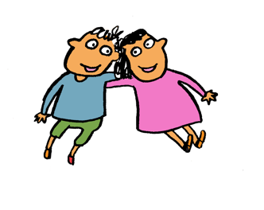
Year 1 Neighbours

Slide 25
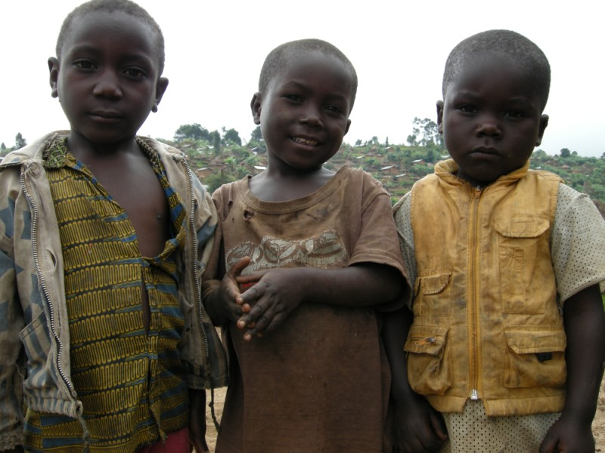
We live in the Democratic Republic of Congo.
It is a country in Africa.
We are neighbours.
Notes:
COUNTRY: Congo Democratic Republic LOCATION: Kanyabayonga
Children outside Kanyabayonga Parish

Slide 26
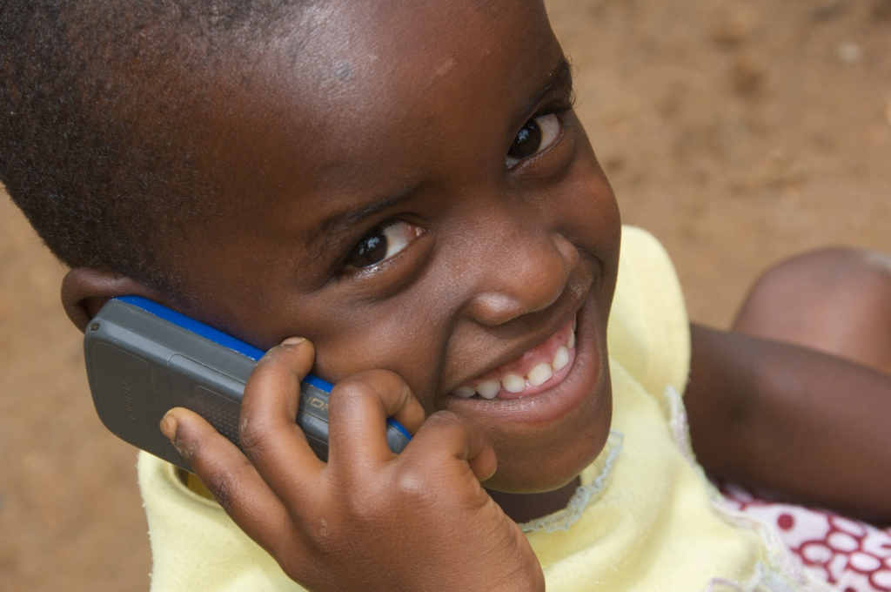
This is Benita.
She lives in Rwanda, in Africa. She is chatting on the phone.
Do you like talking on the phone?
Notes:
Discuss – do you like talking to your friends and neighbours on the phone?
COUNTRY: Rwanda LOCATION: Ruyenzi
Benita, 4yrs, using a mobile phone.

Slide 27
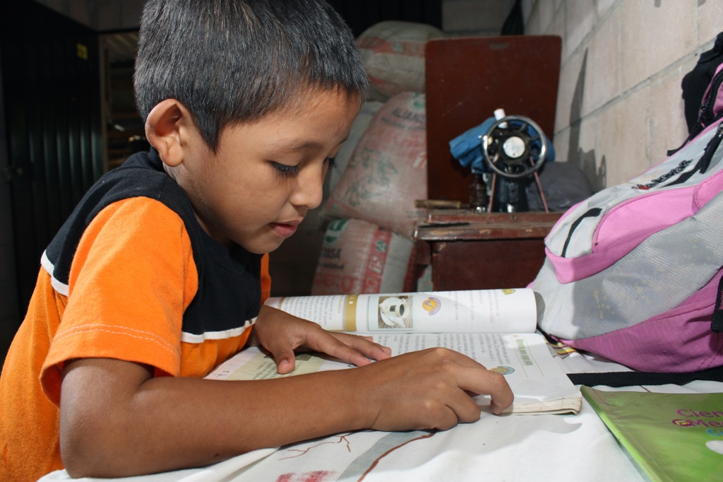
Walter lives in El Salvador.
He is doing homework.
What do you think he is learning about?
Notes:
Discuss what Walter could be learning - Maybe he is learning about his neighbours around the world too!
COUNTRY: El Salvador LOCATION: Puentecitos, Guaymango municipality, Ahuachapán department
Fidel Ramos Gonzalez's youngest son Walter Ovidio, 6yrs doing his homework.

Slide 28
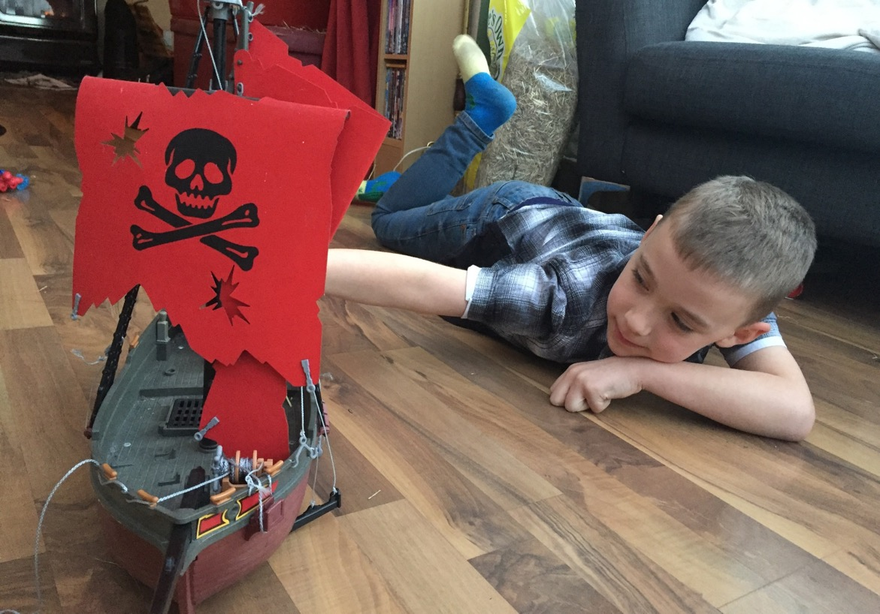
This is Aidan.
He is 6. He lives in the UK.
Aidan likes learning about neighbours near and far.
Notes:
COUNTRY: United Kingdom
Aidan, 7yrs, from Somerset.
Photo credit: David Brinn | CAFOD (2018)

Slide 29
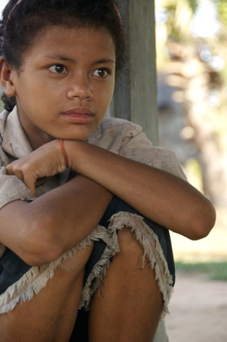
Reun lives in Cambodia.
It is a country in Asia.
He is thinking.
Maybe he is thinking about neighbours around the world, just like you!
Notes:
COUNTRY: Cambodia LOCATION: Samrong Village, Seam Reap
Reun Rak, 10yrs, Ean Poise's nephew. The family is supported by Banteay Srei.

Slide 30
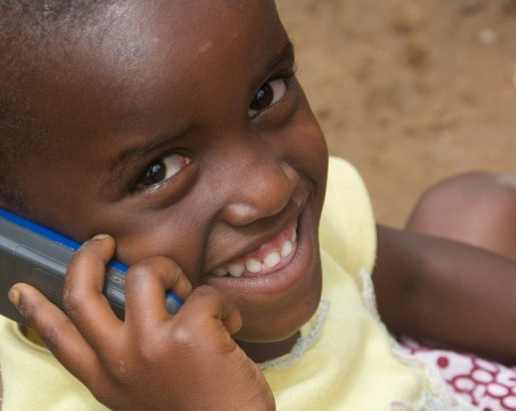
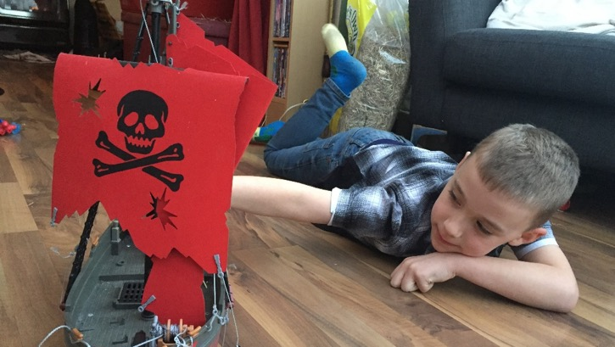
Some neighbours live close to us.
Some neighbours live far away, like the children you have learnt about today.

Slide 31
Tell someone at home about the neighbours around the world you have met today.

Slide 32
Photographs by: Laura Donkin, Annie Bungeroth, Claudia Torres, Kate Stanworth Illustrations: Per Karlen

Slide 33
Think about Isaiah’s words.
What would you tell
our neighbours across the world?
What wondering questions
do you have about our neighbours?
Challenge – why should we tell
of God’s greatness across the world?

Slide 34
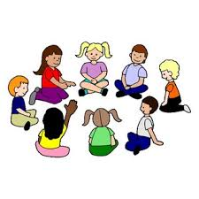
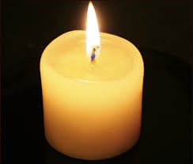
Prayer time
“I pray for our neighbours …”

Slide 35
LEARNING FOCUS: Everyone is our neighbour.
One day someone asked Jesus a tricky question, “Who is my neighbour?” Jesus answered by telling one of his stories, called a parable.
Watch and listen to the story told through Godly play.
https://www.youtube.com/watch?v=QuBNEQq8zOk
Samaritans lived in Samaria and that Jews and Samaritans would have nothing to do with one another. They could not get on because they could not agree about what they believed, so they became enemies.

Slide 36
SOME QUESTIONS TO ASK THE CHILDREN:
Can you answer Jesus’ question – “Which of the three was a neighbour to the man?”
How do you think the injured man felt when the first two men walked away?
What did the injured man need?
Why was it strange that a Samaritan helped?
Think of a time when you have helped someone.
The Good Samaritan made sure the injured man had what he needed. CAFOD works with our neighbours around the world, no matter who they are or what they believe, to make sure they have what they need.

Slide 37
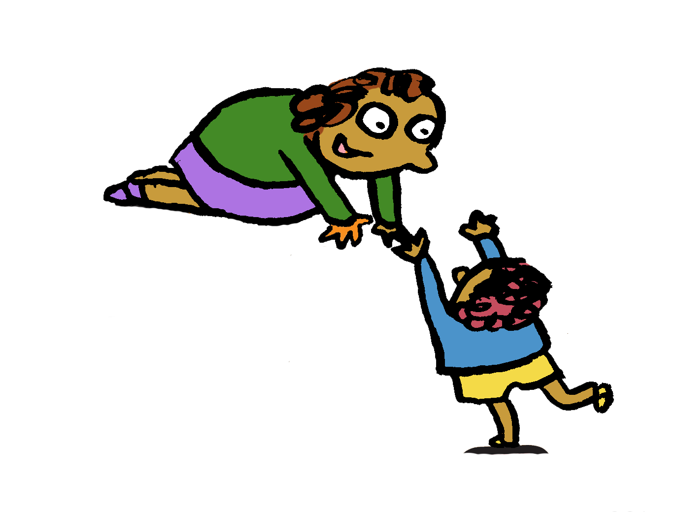
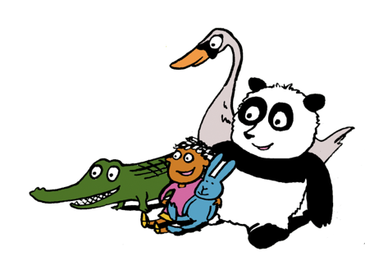
Year 1 Neighbours

Slide 38
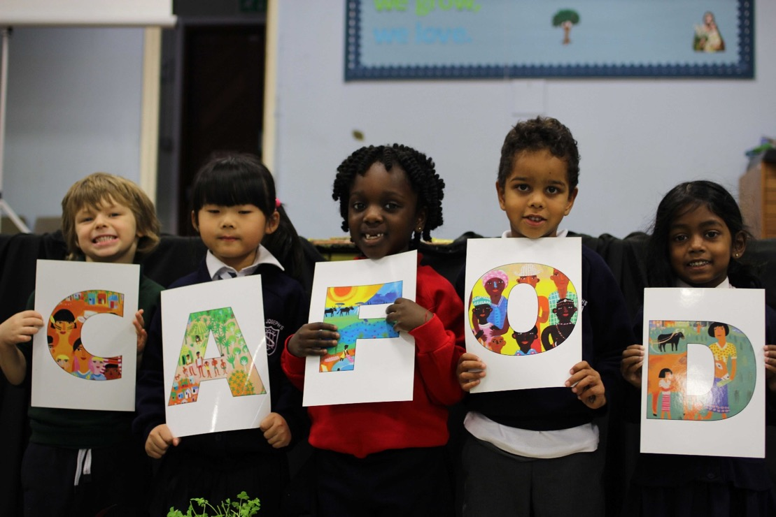
Helping our neighbours.
How does CAFOD help?

Slide 39
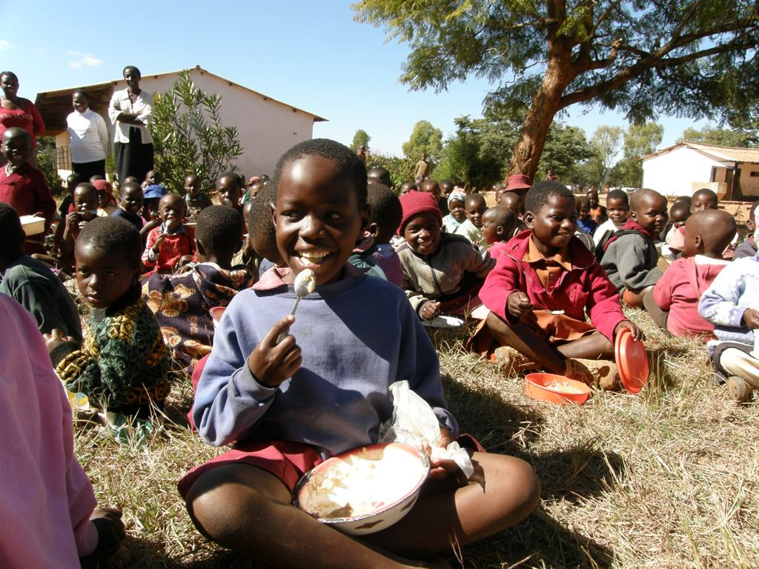
CAFOD helps our neighbours around the world to …
… have
enough food
Notes:
Lunchtime at the Dhirihori Primary School. CAFOD's partner Caritas Zimbabwe responded to the need for humanitarian food aid, as children were fainting in class as families have struggled to find food for their children. The children eat a high-protein porridge made of maize meal. PHOTOGRAPHER: Nana Anto-Awuakye

Slide 40
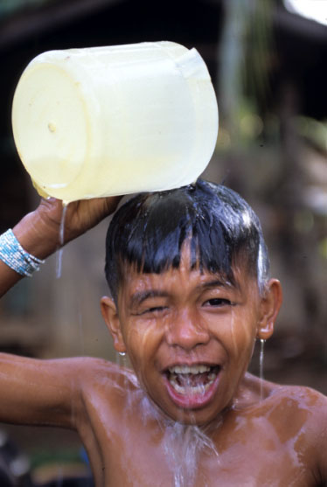
… have clean water
Notes:
Philippines - Christian Joy, 9 is the son of small farmer Jul Yap who also works for JPIP. JPIP, one of CAFOD’s partners, greatly helps the family and their community. They now have piped water, solar powered electricity, organic farming, improved harvests, fewer debts, a motorbike and a cellphone. They now have water nearby so Christian takes a bath more often.
PHOTOGRAPHER: Annie Bungeroth

Slide 41
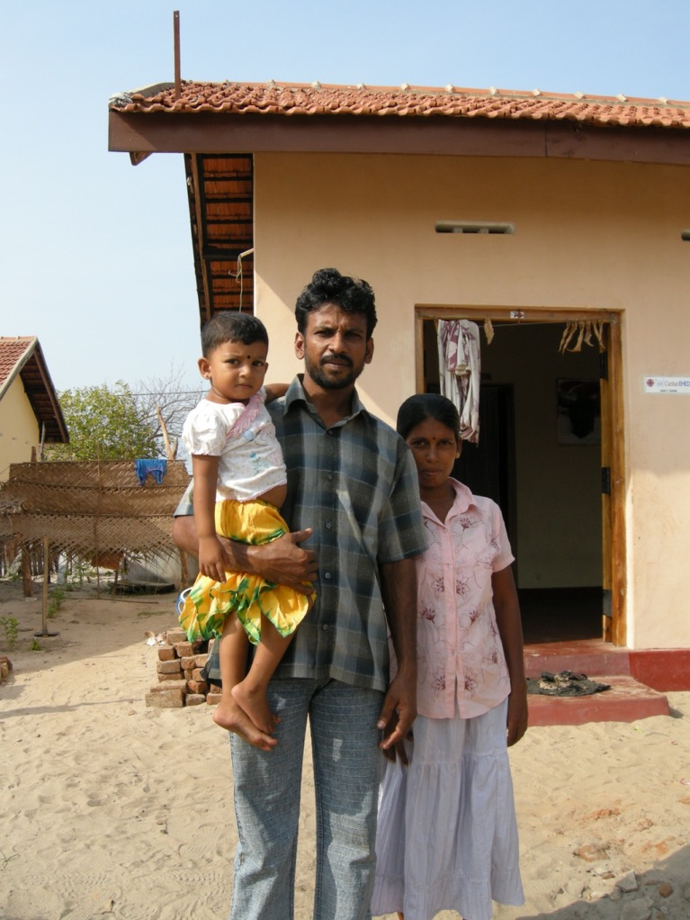
… have a home
Notes:
Sri Lanka
PHOTOGRAPHER: Lucy Morris
New house for tsunami-affected household constructed with CAFOD funds (Disasters Emergency Committee).

Slide 42
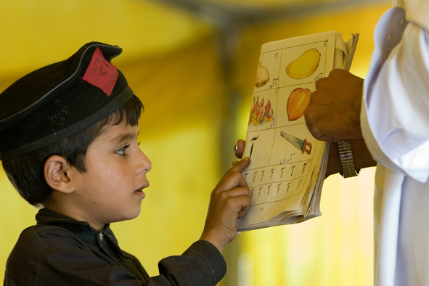
… go to school
Notes:
COUNTRY: Pakistan
Student at Government Primary School Nakka Beesan works on his reading lesson with his teacher. He attends classes inside a tent provided by CRS (one of CAFOD’s partners) as his school collapsed in the 8/10/2005 earthquake, killing two students. CRS also provided each student with study materials to help them get back to school.
PHOTOGRAPHER: Jim Stipe

Slide 43
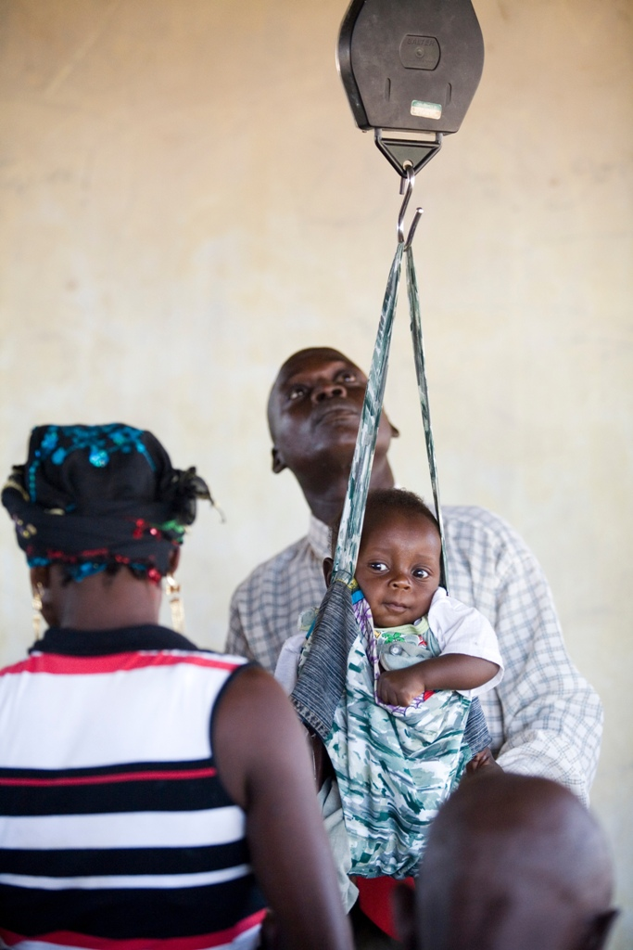
… go to a doctor if they are unwell
Notes:
COUNTRY: Nigeria
LOCATION: Yakoko, Zing Local Authority, Taraba State, North East Nigeria
CAPTION: The clinic keeps a check on the weight of the babies that come here to monitor any weight loss which could indicate illness
PHOTOGRAPHER: Simon Rawles

Slide 44
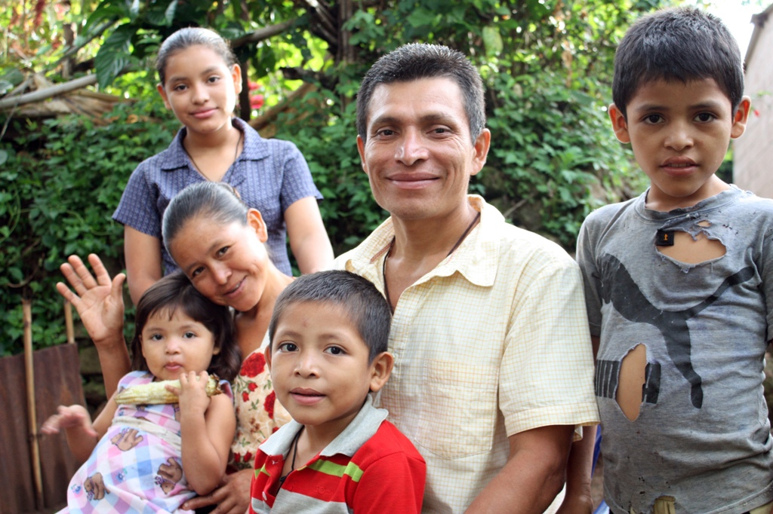
CAFOD works with neighbours all around the world to make sure they have what they need.
Notes:
CAFOD works with neighbours around the world no matter who they are or what they believe, to make sure they have what they need.
Photo:
COUNTRY:El Salvador
Ramos Laguan family including Fidel Ramos Gonzalez, his wife Julia de Jesus Laguan, and their children Sarita, 15yrs, Marisol, 13yrs, Ronaldo Adrian, 9yrs, Walter Ovidio, 6yrs and Raquel Guadalupe, 4yrs.
PHOTOGRAPHER: Claudia Torres

Slide 45
Photographs by: Claudia Torres, Simon Rawles, Jim Stipe, Lucy Morris, Annie Bungeroth, Nana Anto-Awuakye. Illustration: Per Karlen

Slide 46
On the template of the person, write and draw how you can help our neighbours around the world.
Show your learning…

