Slide 1
Year 4
Reconciliation topic

Slide 2
Year 4
RECONCILIATION – INTER-RELATING
Come and See for yourself
EXPLORE
Networks of friendships and relationships enable human beings to live together. When a child’s power to reach out, trust and make friends is diminished, they may suffer the effects for a lifetime. Both children and adults have to discover their ability to reach out and repair what has been damaged.
If human beings are to live together in relationships, there is always need for reconciliation.
Recall a time when you were reconciled to someone else.
What or who made the reconciliation possible?
How might that person have felt?
How did you feel?
REVEAL
Christians believe that, in Jesus Christ, the world has been reconciled to God. Through and in Christ, every human being is offered the power to reach out in forgiveness and peace, to receive and to offer reconciliation.
Background notes for parents

Slide 3
Background notes for parents
Word of God
St. Paul in his letter to the Ephesians, wrote:
“But now in Christ Jesus, you that used to be so far apart from us have been brought very close, by the blood of Christ. For he is the peace between us, and has made the two into one and broken down the barrier which used to keep them apart, actually destroying in his own person the hostility caused by the rules and decrees of the Law.” Ephesians 2:14-15
How can the example of Christ bring people closer together?
How does his example of making peace help you?
Catechism of the Catholic Church
“It is called the Sacrament of Reconciliation, because it imparts to the sinner the love of God who reconciles: ‘Be reconciled to God’. He who lives by God’s merciful love is ready to respond to the Lord’s call: ‘Go; first be reconciled to your brother’...
Indeed the Sacrament of Reconciliation with God brings about a true ‘spiritual resurrection’, restoration of the dignity and blessings of the life of the children of God, of which the most precious is friendship with God.” CCC1424, 1468

Slide 4
Background notes for parents
RESPOND
Are there any areas in the life of the school where you think it might be necessary to restore broken relationships?
What opportunities are there in the classroom for restoring relationships when misunderstanding or hurt arise?
How is reconciliation truly celebrated?
Prayer and Reflection
I have chosen the way of faithfulness; I set your ordinances before me. I cling to your decrees, O Lord; let me not be put to shame. I run the way of your commandments, for you enlarge my understanding. Teach me, O Lord, the way of your statutes, and I will observe it to the end. Give me understanding that I may keep your law and observe it with my whole heart. Amen. (Psalm 119: 30-34)

Slide 5
EXPLORE
Building bridges of friendship
STANDARD INDICATOR
Some children will be able to ask and respond to questions about their own and others’ experience and feelings about what breaks and what mends a friendship. Some children will be able to ask questions about what they and other wonder about how friendships may be restored.
Some children will be able to make links to show how feelings and beliefs affect their behaviour and that of others in respect to maintaining friendship. Some children will be able to compare their own and other people’s ideas about questions of building and maintaining friendship and realise that these questions are difficult to answer.
KEY WORDS
bridges, friendship
Background notes for parents

Slide 6
LEARNING INTENTION: Building bridges of friendship.
Let’s think about bridges. What do they do and why do we need them?

Slide 7
A bridge needs to be built from both sides. A bridge must be strong enough for people to walk on. Bridges span or stretch across things.
A bridge needs to be cared for and looked after otherwise it will just fall down.

Slide 8
Read the story ‘A bridge of friendship’.

Slide 9
A friendship is like a bridge between people - it needs to be strengthened, maintained or repaired.
Think about these questions.
What brought Charlotte and Poppy together as friends?
Why do you think the friendship faded?
What do you think about Poppy?
What do you think Charlotte might do?
Has anything like this ever happened to you?
How did you feel?
What did you do to mend the friendship?

Slide 10
Show your learning…
Make a list of friends you have had for a long time.
For each friend, record:
How did you meet your friend?
What made you become friends?
What do you do together?
What do you like about your friend?
Make a card or send a message to your friends to tell them ‘Why we made friends’ and ‘Why we stayed friends’.

Slide 11
Background notes for parents
REVEAL
The importance of admitting wrong, and being reconciled
with God and one another
CONTENT: – scripture – tradition – prayers
STANDARD INDICATOR
Some children will be able to use a developing religious vocabulary to describe some religious actions and symbols used in the Sacrament of Reconciliation. Some children will be able to use religious words and phrases to give reasons for some religious actions and symbols used in the Sacrament of Reconciliation.
Some children will be able to make links to show how feelings and beliefs about reconciliation affect their behaviour and that of others. Some children will be able to give reasons why believers ask forgiveness of others and forgive those who have hurt them.
KEY WORDS
sin, contrition, absolution, Sacrament of Reconciliation, Examination of Conscience, confession, penance

Slide 12
LEARNING FOCUS 1: Everyone is loved by Jesus.
Imagine yourself as a lost sheep. You will hear Jesus calling you; you will come out from a hiding place where they have gone because they know they have done wrong. Like the lost sheep, you allow yourself to be led home.
Click on the link to listen to a guided meditation. Sit or lie with your eyes closed in a comfortable position….be as still as you can.
https://www.youtube.com/watch?v=GA_CeO7v4ZM

Slide 13
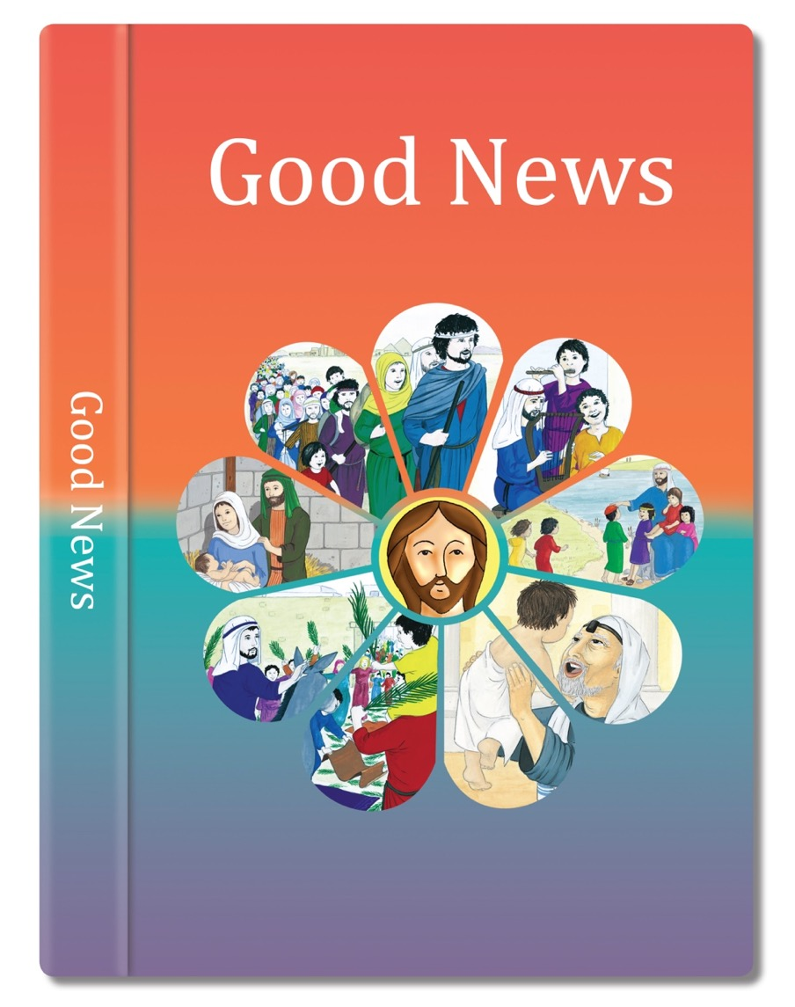
Now read the story from the scripture….

Slide 14
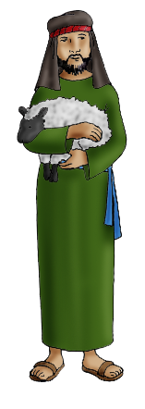
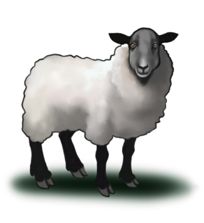
One day Jesus said, “Suppose one of you has a hundred sheep and loses one of them.
“It’s like that with people,” Jesus told them.
“If ninety-nine people stay close to God that’s good.
What do you do? You leave the other ninety-nine sheep grazing on the hillside and go looking for the one that got lost until you find it.
But if one who has turned away from God and done something wrong says sorry and comes back to God, then that is a reason to celebrate.
When you find it, you are so happy that you put it on your shoulders and carry it back home.
God is like the good shepherd, always searching for the lost sheep, looking out the person who has turned away.”
Then you call your friends and neighbours together.
“I am so happy,” you say, “because I have found my lost sheep. Let’s celebrate!”
Based on Luke 15: 3-7
God’s Story 3

Slide 15
Think about these questions….
How did you feel during the reflection?
What did the story of The Lost Sheep mean to you?
Did it surprise you that the shepherd would go to find the one lost sheep?
What did you think the 99 others did?
When are the times you might see yourself as the lost sheep?
What does this story tell you about God?

Slide 16
The Sacrament of Reconciliation brings us back to God, who forgives us and absolves us from our sins. God’s mercy and love is like the tenderness shown in the story. We can be sure God loves us.

Slide 17
Show your learning…
Create a spiritual journal page for The Lost Sheep scripture reading.
Include words from the scripture.
See the guidance on the next slides.

Slide 18
Spiritual Journaling What is it?
A way to truly encounter the word of God
A means to grow closer to the Lord
Sketching what you are thinking about in writing or picture form
Freedom to draw or write whatever comes to your mind

Slide 19
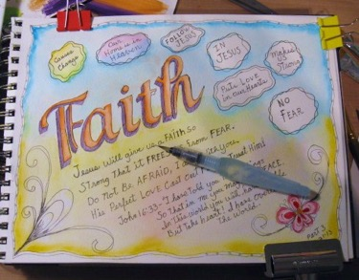
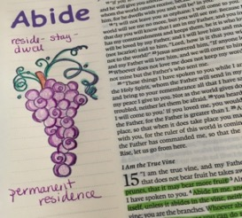
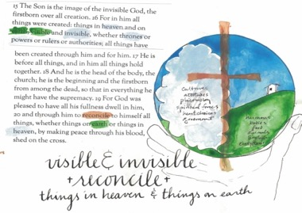
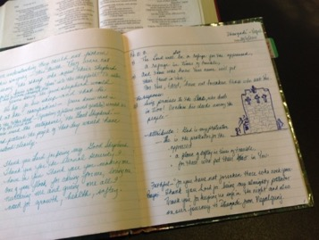
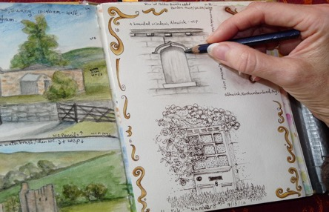
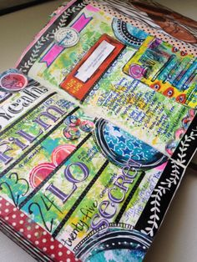
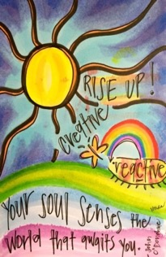
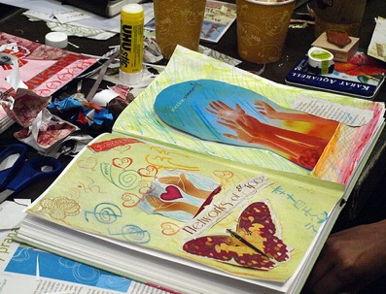
Examples

Slide 20
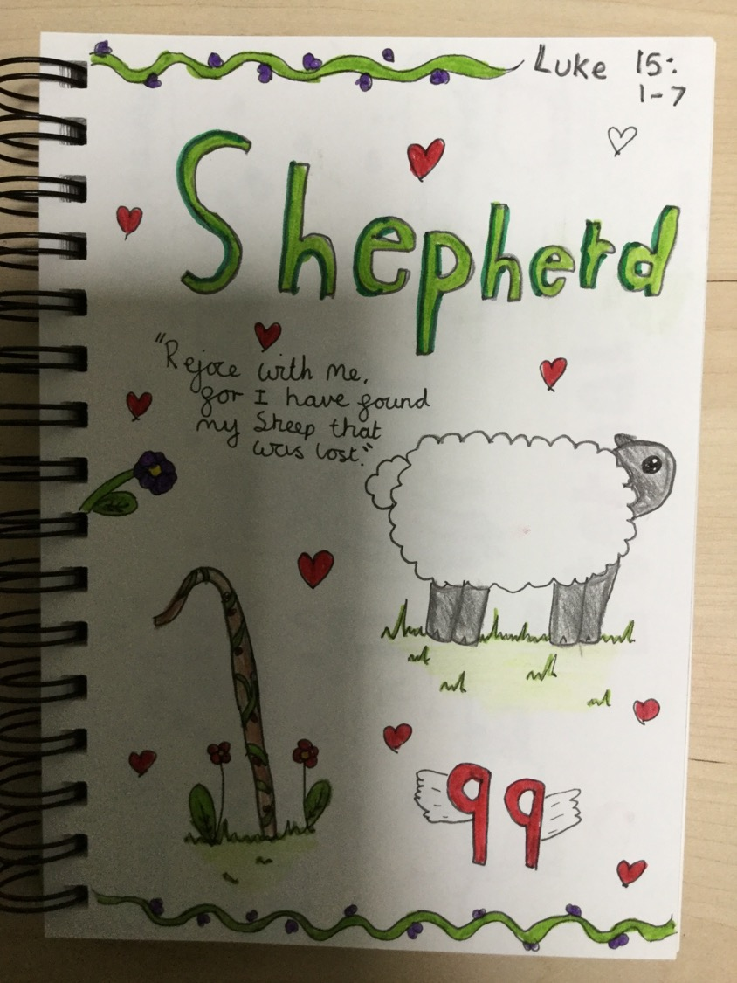

Slide 21
LEARNING FOCUS 2: Sin and Examination of Conscience.
I can use a developing religious vocabulary to describe some religious actions and symbols used in the Sacrament of Reconciliation.
I can use religious words and phrases to give reasons for some religious actions and symbols used in the Sacrament of Reconciliation.
What is a sin?

Slide 22
People get lost when they deliberately do something wrong, hurting others, themselves or the world they live in. That is what is called ‘sin’. It is anything deliberately chosen – to think, say or do. It is also anything you choose do or not do that spoils or breaks the friendship with God and with other people. Sin is anything which breaks bridges of love.

Slide 24
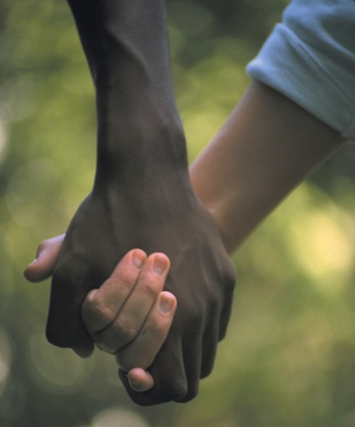
When Jesus was teaching, someone came up to him and asked him what he thought was the greatest commandment of all.
“Love your neighbour as yourself. There is no other commandment more important than these two.’
This is what Jesus replied:
‘You must love the Lord your God with all your heart, with all your soul, and with all your mind, and with all your strength.”
The second most important commandment is this:
Based on Mark 12: 30-31
(Come and See)

Slide 25
SOME KEY QUESTIONS TO THINK ABOUT:
What does “examine your conscience” mean?
When is it good to think about it? What will it lead us to do?
Which is easier – to love God or to love your neighbour? Is there a difference?
Why do you think love of God and love of our neighbour is so important?
What would be another commandment?
How would you define ‘sin’?

Slide 26
Christians try to build bridges towards one another every day. They ‘examine their consciences’ to see how they have kept these two commandments.
Our conscience is like a voice or feeling inside us. This is the Holy Spirit helping us to respond to God. If we pay attention to the Holy Spirit, it will help us to know if something is good or bad. It is good to think every evening, before you go to bed, about how you have built bridges of love and friendship or, perhaps, broken them through sin.
We remember if we have done something that hurt someone else or if someone else has hurt us. We can thank God for all the good and say sorry for the bad and know that God, like the good shepherd, cares about us and loves us. We also must try to forgive those who have hurt us.

Slide 27
Show your learning…
Think about the ways in which God’s law of love can be broken – thinking, saying or doing anything that spoils or breaks friendship with God or with other people. It is also choosing not to do something which again results in breaking friendship with God and other people.
Using the title ‘Building Bridges’ write a short story/account to show a time when a bridge of friendship was broken and how it was rebuilt through good action and kindness.
Try to give examples and make links to relevant Scripture.
You make a film of your story or draw it as a storyboard.

Slide 28
LEARNING FOCUS 3: The Sacrament of Reconciliation: contrition.
I can use a developing religious vocabulary to describe some religious actions and symbols used in the Sacrament of Reconciliation.
I can use religious words and phrases to give reasons for some religious actions and symbols used in the Sacrament of Reconciliation.
Do you remember the
Stages of Reconciliation?
The penitent (person confessing his/her sins), takes time to examine their conscience (life). This means to think about the times they have not followed Jesus’ way of love and kindness.
The priest welcomes the penitent, and they both make the Sign of the Cross.
The penitent confesses (tells the priest his/her sins).
The priest talks kindly to them and encourages them to do or say something to make up for what they have done wrong. This is called a penance.
The person then prays an act of sorrow, which includes the promise to try not to do the same again.
The priest says the words of forgiveness and absolution.
The person leaves the priest and prays and thanks God for forgiving them and completes the penance the priest has asked them to do.

Slide 29
The Sacrament of Reconciliation is also called Confession, Penance and Sacrament of Forgiveness. This Sacrament has been given to us to confess or acknowledge our sins, seek forgiveness and be reconciled to God and one another. It is like a bridge. It helps Christians to live as followers of Jesus, knowing that forgiveness leads to joy and peace. In this sacrament, those receiving it may be sure of the love and mercy of God.

Slide 30
The most important thing that people preparing to receive the Sacrament of Reconciliation need is to be sorry for their sins. There is a special word for this – ‘contrition’.
When you have had a quarrel with someone, you can never make up unless you are really and truly sorry – that is, if you have contrition. It about realising the consequences of what you have done, the hurt you have caused to others, as well as to yourself. When you have contrition, you will try very hard not to sin again and there will be peace in your heart.

Slide 31
God expects us to build bridges with our family and friends before we can take our place in church. Listen to what Jesus says in Matthew’s Gospel:

Slide 32
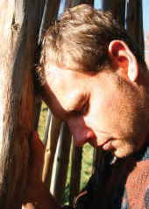
So if you are about to offer your gift to God at the altar and there you remember that another has something against
you, leave your gift there in front of the altar, go at once and make peace with that person, and then come back and offer your gift to God.
Based on Matthew 5: 23-24
(Come and See)

Slide 34
What is the man in the picture is doing?
What makes you think he is sorry for something?
How does this picture make you feel?
How do you feel when you have done something wrong?
What is the next thing you might do?

Slide 35
What is happening in this second picture?
How does sin affect others and yourself?
Why is contrition so important?
Why did Jesus say that it is no good putting gifts on the altar if you are not at peace with someone?

Slide 36
Show your learning…
Try and speak about what ‘Contrition’ means for 1 minute.
Ask a family member to time you.
No urms, pauses, hesitation or reading from a sheet!!
Can you complete the challenge??

Slide 37
LEARNING FOCUS 4: Penitential Rite 1 and 2.
LEARNING FOCUS 5: Absolution.
I can use a developing religious vocabulary to describe some religious actions and symbols used in the Sacrament of Reconciliation.
I can use religious words and phrases to give reasons for some religious actions and symbols
used in the Sacrament of Reconciliation.
There are two different ways of celebrating the Sacrament of Reconciliation. Rite 1 and Rite 2.
Remember rite means ritual or ceremony, a way of doing things.

Slide 38
In Rite 1, individuals will make their Confession to the priest. Before they do that, they will have prayed and thought carefully about their life, have contrition and want to make a new start. They will tell the priest their sins and listen carefully to his advice.

Slide 39
Sometimes Rite 2 of the Sacrament of Reconciliation is used. This often happens in Advent and Lent when people gather together to prepare for the feasts of Christmas or Easter.
In Rite 2, a number of people come together for the Sacrament of Reconciliation, often with a few priests who have come from neighbouring parishes. There is a service of prayers and readings, which help people to prepare. They are then invited to make a personal confession to one of the priests available. Sometimes schools will have a Penitential Service with the opportunity for confession, Rite 2.

Slide 40
Whatever a person talks to the priest about is in absolute confidence. They can feel that they are talking to God alone. When the confessions are finished, the priest invites everyone to thank and praise God for his mercy and forgiveness.

Slide 41
The priest is saying the words of absolution at the end of the Sacrament of Reconciliation.

Slide 42
When we do something wrong and then later feel sorry about it, we want to make up for it in some way. This is a sign that we will try to do better in the future. The priest gives the person a penance to fulfil. Sometimes it is a prayer to say or sometimes the priest might ask the person to do something extra.
Then, after the person prays an Act of Sorrow, the priest raises his hands as a sign of God’s love and says the words of forgiveness and absolution. He asks God to forgive and absolve the person from their sins. To be absolved of sin means to be free from sin. Those sins are no longer part of your life.

Slide 43
This sacrament is a special way to experience God’s love and peace. The person usually stays in church or in a quiet place to say their penance, if it is a prayer. They will thank God for this opportunity to experience his love and forgiveness and promise to try to do better.
SOME KEY QUESTIONS
What does it mean to be absolved?
Why does the priest raise his hands?
Who does the priest ask to forgive and absolve their sins?
Why do you think there is a choice for the priest to give a prayer or an action for the penance?

Slide 44
Show your learning…
Imagine you have a friend about receive The Sacrament of Reconciliation for the first time.
Make a poster / leaflet to explain what will happen and why it is important.
Include the key words - sin, contrition, absolution, Sacrament of Reconciliation, Examination of Conscience, confession and penance.

Slide 45
LEARNING FOCUS 6: Bridge building in the Christian community.
I can make links to show how feelings and beliefs about reconciliation affect their behaviour and that of others.
I can give reasons why believers ask forgiveness of others and forgive those who have hurt them.
How easy do you
find it to build bridges?
A stranger takes your scooter?
What if your best friend smashes your tablet screen?
or

Slide 46
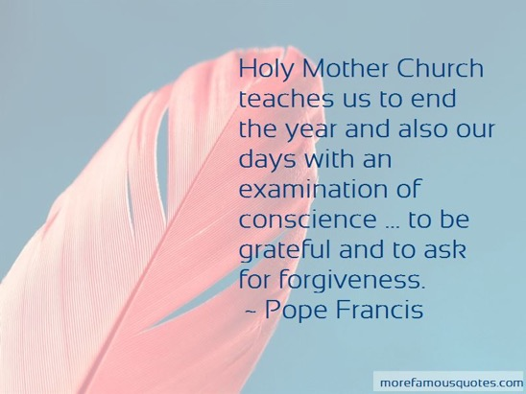
What have we learnt so far?

Slide 47
One day when Pope John Paul was blessing all the people in the crowded Square of St Peter’s in Rome, one man in the crowd fired his gun and the bullet hit Pope John Paul in the stomach.

Slide 48
Immediately, his car gathered speed to take him away and his bodyguard took care of his wounds. He was rushed to hospital and everybody thought he would die.

Slide 49
Luckily, he didn’t die and he lived to carry on his life and good works. One day, he decided he would go to the prison where the assassin was being held. He wanted to show he had forgiven this man for what he had done. The two men made peace with one another. Much later when the Pope died, the man was seen at his funeral.

Slide 51
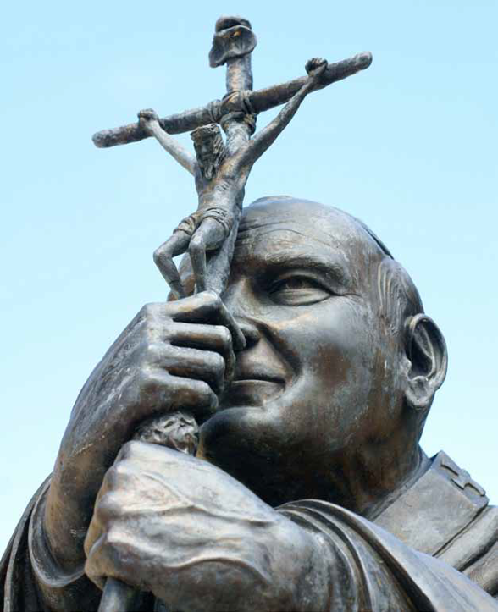
As God’s chosen ones, holy and beloved, clothe yourselves with compassion, kindness, humility, meekness, and patience.
Put up with one another and, if anyone has a complaint against another, forgive one another; just as the Lord has forgiven you, so you also must forgive.
Above all, clothe yourselves with love, which binds everything together in perfect harmony.
And let the peace of Christ rule in your hearts, that is why you belong to the Christian family.
And always be thankful.
Based on Colossians 3: 12-15
(Come and See)

Slide 53
Let’s think about…
Did anything impress you in this story?
Which of the words in St Paul would you think describes the Pope’s action?
What are the reconciliation words that Paul mentions?
How did Pope John Paul II build a bridge?
How does Paul suggest we can build bridges when we fail in Jesus’ commandment?
If you have fallen out with a good friend what could you do to reach out to them, to build a bridge towards them?

Slide 54
Show your learning…
Imagine you are a news reporter and you have heard about what Pope John Paul II did to show forgiveness.
Write down the questions you would ask the Pope and the answers you think he would give.
Try to include the reasons he was able to forgive – think about the scripture from this topic.

Slide 55
RESPOND
Remembering, celebrating and responding to building bridges of friendship and the importance of admitting wrong and being reconciled with God and one another
Remember
Start the session with a moment of quiet reflection. Light a candle and make the sign of the cross.
Is there is anything you wonder and ask questions about:
What makes friendships strong.
How decisions about friendship are informed by beliefs and values.
How bridges of friendships are built.
How friendships may be restored when they have been broken.

Slide 56
Remember
The meaning of the story of The Good Shepherd (lost sheep).
God’s mercy and love is like the tenderness shown in the story.
The Sacrament of Reconciliation brings us back to God, who forgives us and absolves us from our sins.
Sin and the importance of examining your conscience.
The greatest commandment – love of God and others.
Other names for the Sacrament of Reconciliation: Confession, Penance and Sacrament of Forgiveness.
The meaning of contrition and absolution.
Forgiveness of others.
Rejoice
Can you say a prayer and use some music to reflect on your learning?
Apply your learning
How can I build a bridge towards someone today?
Some suggested ideas
After a time of quiet reflection and prayer:
Think about what you could do to build a bridge towards a person you have hurt or just don’t play with much, or someone who has hurt you.
Write on a card what you will do to build a bridge.

