Slide 1
Year 4
Islam
Holy Books

Slide 2
OVERVIEW FOR ISLAM – YEAR 4
HOLY BOOKS: THE QUR’AN
Judaism is studied by everyone and Islam one of the options of choice from the three other religions. It is taught for one week every year. The themes are the same for all religions.
BACKGROUND NOTES
Muslims are followers of the religion of Islam, which began in Saudi Arabia around the seventh century. They believe in one God, Allah. There are two main groups of Muslims, Shi’ah and Sunni. The Sunnis are the larger group. Their beliefs are similar but they differ on the forms of leadership. What the children learn in this programme of study is a middle way, offering what is most general in Islam. The spelling used is Makkah rather than the common version
Mecca to avoid confusion.

Slide 3
There are six major religions in our world.

Slide 4
Watch this video to refresh your learning about Islam.
https://www.truetube.co.uk/film/alien-abduction-islam
TEACHING POINTS
Whenever Muhammad’s name is mentioned Muslims say
‘Peace and blessing be upon him’ (pbuh

Slide 5
Look: Important books
Think about the books you use.
Which is the most important book for you?
One that you treat very carefully, are proud of and would like to keep always. This might be a photo album, a souvenir of special football match or a wedding.
It might be a book given as a prize or a gift from someone special.
How do you care for and value the book?

Slide 6
Discover: The Qur’an.
The Qur’an is the Muslims’ most holy book. Muslims believe that it contains the actual words of Allah spoken to Muhammad by the angel Jibril (we would say Gabriel). It took 23 years for the angel to give Muhammad the whole message. Later Muhammad dictated the message to some of his followers, who wrote it down in Arabic.
The words of the Qur’an have remained unchanged since the time of Muhammad. In it, Allah tells Muslims how they should worship him and also how they should behave towards each other. It is a collection of signs of Allah’s existence and instructions for how Muslims should live their lives. It is the Muslims’ guidebook for life.

Slide 7
For Muslims, the Qur’an is a very special book and so they treat it with great respect and honour. It is always placed
in a higher position that any other book and no other book is ever placed on top of it. To keep it clean it is wrapped in
a special cover. Before Muslims read it, they take off their shoes and wash their hands. It never touches the ground so when it is used in prayer it is put on a stand.
https://www.truetube.co.uk/film/holy-books-quran

Slide 8
Discover: The importance of the Qur’an.
Children learn to read the Qur’an in Arabic and their own language from a very early age. They go to Islamic classes after school and at the weekends. They also learn about the prophet Muhammad. Children will read the Qur’an at home with their parents and learn parts of it off by heart. The Qur’an contains guidance for how they should live their lives.

Slide 9
Here are the first words of the Qur’an:

Slide 10
Think and discuss…
Q How do you think it helps to learn the Qur’an off by heart?
Q What are the different ways of learning the Qur’an?
Q What did you notice about the way the Qur’an was being read? (Right to left and starting at what would be for us the end of the book.)
Q What do the opening words of the Qur’an tell you about its purpose?

Slide 11
Discover: The 99 beautiful names for Allah.
The Qur’an contains 99 beautiful names for Allah. Each name describes the nature or characteristics of Allah. Many Muslims use a subha, a string of beads to recite their names and to count their prayers. The subha is made up of three sets of thirty-three beads and one large bead making one hundred in total. They are often made from wood or plastic.
The ninety-nine beads are used to say the ninety-nine names for Allah during prayer. Muslims believe that repeating his name over and over brings them closer to God.
Some of those names are:
• The gentle
• The all-forgiving
• The all-knowing
• The Creator
• The all-seeing
• The strong
• The truth
• The giver of life

Slide 12
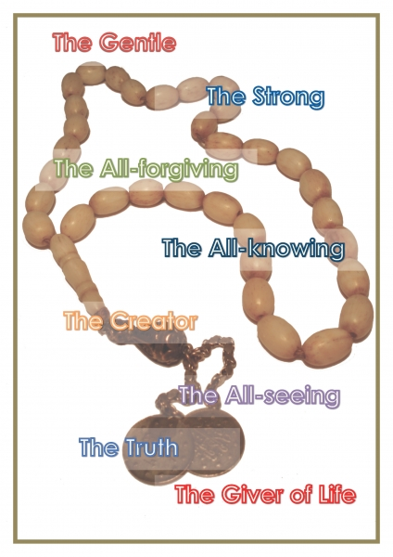
http://www.bbc.co.uk/learningzone/clips/the-quran/320.html
Prayer beads

Slide 13
The Qur’an stresses the importance of respect for human life and this includes responsibilities between parents and their children. It tells children to obey their parents and look after them and to care for them when they get old.
Show kindness to parents and to relations and orphans and the needy’ (4.36)
Q Why do you think there are so many names?
Q Which one do you like best and why?
Q What do you think the world would be like if everyone respected and cared for their parents?

Slide 14
Show your learning…
Make a mindmap to show what you have learnt about the Qur’an.
The Qur’an

