Slide 1
Collective Worship
Week commencing 18 May 2020

Slide 2
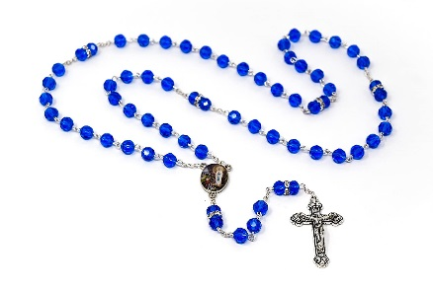
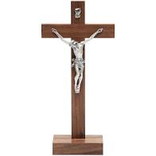
Make sure that you are sitting comfortably and that you are somewhere quiet.
Try to make sure that you will be able to think quietly and without distractions for a few minutes.
If you have one you might like to place a crucifix, a set of rosary beads, a bible, or another religious object next to your screen. Your worship is different to anything else from school that you will do today.
When you are ready, move on to the next slide.

Slide 3
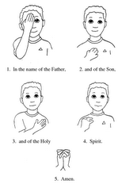
In the name of the Father, and of the Son, and of the Holy Spirit. Amen.

Slide 4
We are still in the season of Easter.
In today’s Gospel we are going to read about Jesus looking ahead to Pentecost and promising his disciples that they would not be left alone, but that the Holy Spirit would be with them.

Slide 5
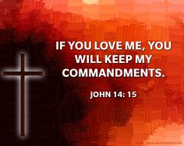
A reading from the Gospel of John
Jesus said to his disciples:
“If you love me, you will do as I command. Then I will ask the Father to send you the Holy Spirit who will help you and always be with you. The Spirit will show you what is true.
You know the Spirit, who is with you and will keep on living in you.
I will not leave you on your own. I will come back to you. And because I live, you will live. Then you will know that I am one with the Father. You will know that you are one with me, and I am one with you.”

Slide 6
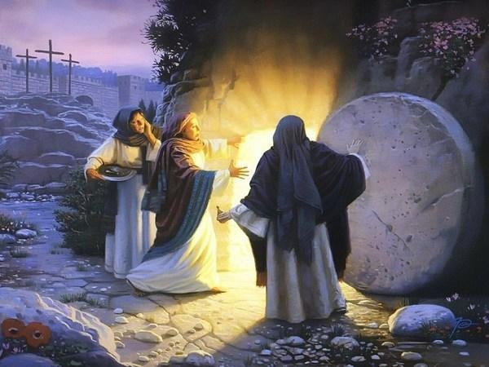
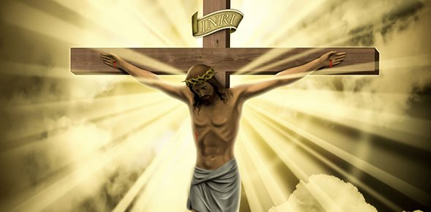
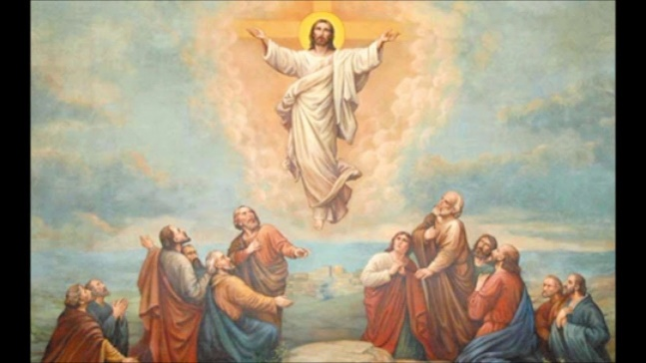
Jesus was speaking to his disciples before his death and resurrection.
He told his friends that he would be leaving them, would be coming back to them, and then would be going to be with the Father. He was telling them that he was going to die, be raised from the dead, and then ascend into heaven, although at this time his disciples could not understand.

Slide 7
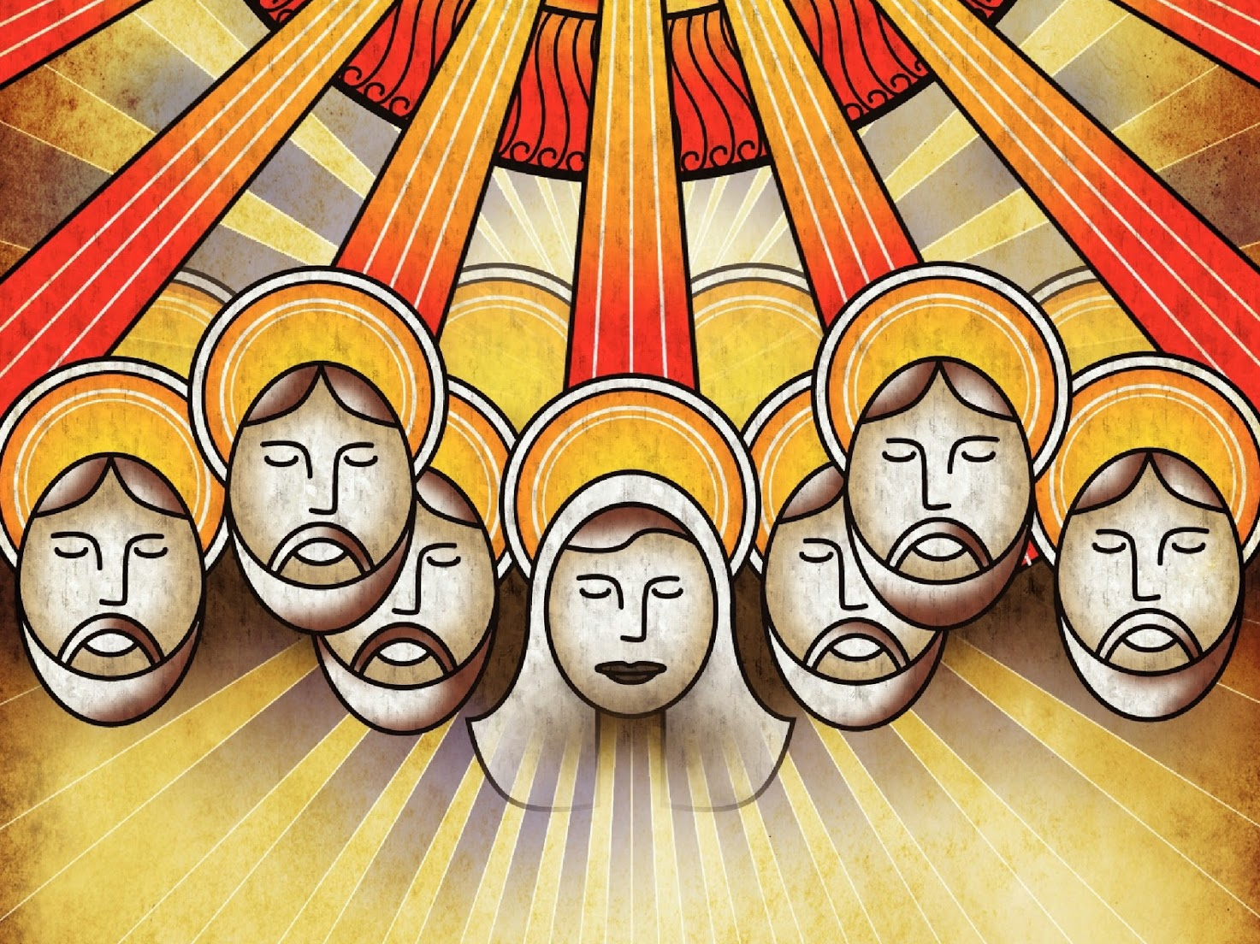
We will celebrate Pentecost on Sunday 31 May (fifty days after Easter Sunday).

Slide 8
In today’s reading Jesus talks about:
The Father
The Holy Spirit
This is called the Holy Trinity:
God the Father – God the Son – God the Holy Spirit

Slide 9
This drawing uses symbols to illustrate the Trinity.
What can you see in the illustration?
There is ONE picture, but there are THREE symbols.

Slide 10
The hands represent God the Father
Creator

Slide 11
The cross represents God the Son
Saviour

Slide 12
The dove represents God the Holy Spirit
Energiser

Slide 13
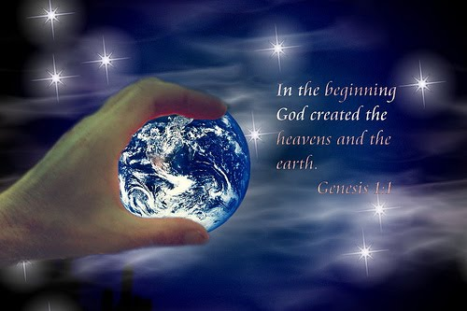
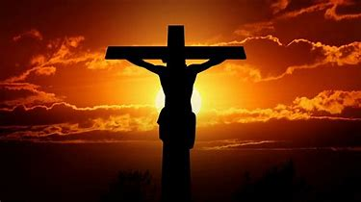
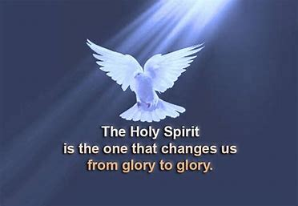
The reading is a reminder that
God MADE
God SAVED
God CONTINUES TO LIVE AND TO CHANGE THE WORLD
One God, three persons

Slide 14
The reading starts, “If you love me …”
Jesus makes a promise, but expects us to do something first.
“If you love me …”
Jesus promises to ask the Father to send the Spirit to help us live like Jesus … to help us to show our love for God.
Love of God has to come first, Jesus says.

Slide 15
What can you do today to show a love of God?
Can you spend some time talking to God, and listening to God talking to you?
Could you write or read some prayers?
How can you be especially kind to a friend or family member?
Is there something you could do to show that you care for the environment?
What ideas of your own have you got?

Slide 16
Here is a link to a simple hymn to listen to or join in with, celebrating the Trinity: God the Father, God the Son, God the Holy Spirit.

Slide 17
Prayer
Let us be still and silent for one minute. Let us think of someone or something we would like to pray for or about today.
Let us pray for those who are sick or lonely or anxious or afraid; those who have died; those who mourn because someone they love has died; those far away from home; those who feel that they have no-one else to pray for them. Let us pray that their lives may be touched today by the loving hand of God. Amen.

Slide 18
Share a prayer
Dear God, I pray today for everyone in our school. I ask you Lord to look after all of the children, all of the adults and all of the families. I ask you Lord to keep us all safe.
Help me today to show my love for you, Father, Son and Holy Spirit, through the things I think, do and say.
Amen.

Slide 19
In the name of the Father, and of the Son, and of the Holy Spirit. Amen.

