Slide 1
Year 2
Reconciliation topic
‘Rules’

Slide 2
Year 2
RECONCILIATION – INTER-RELATING
Come and See for yourself
EXPLORE
Networks of friendships and relationships enable human beings to live together. When a child’s power to reach out, trust and make friends is diminished, they may suffer the effects for a lifetime. Both children and adults have to discover their ability to reach out and repair what has been damaged.
If human beings are to live together in relationships, there is always need for reconciliation.
Recall a time when you were reconciled to someone else.
What or who made the reconciliation possible?
How might that person have felt?
How did you feel?
REVEAL
Christians believe that, in Jesus Christ, the world has been reconciled to God. Through and in Christ, every human being is offered the power to reach out in forgiveness and peace, to receive and to offer reconciliation.
Background notes for parents

Slide 3
Background notes for parents
Word of God
St. Paul in his letter to the Ephesians, wrote:
“But now in Christ Jesus, you that used to be so far apart from us have been brought very close, by the blood of Christ. For he is the peace between us, and has made the two into one and broken down the barrier which used to keep them apart, actually destroying in his own person the hostility caused by the rules and decrees of the Law.” Ephesians 2:14-15
How can the example of Christ bring people closer together?
How does his example of making peace help you?
Catechism of the Catholic Church
“It is called the Sacrament of Reconciliation, because it imparts to the sinner the love of God who reconciles: ‘Be reconciled to God’. He who lives by God’s merciful love is ready to respond to the Lord’s call: ‘Go; first be reconciled to your brother’...
Indeed, the Sacrament of Reconciliation with God brings about a true ‘spiritual resurrection’, restoration of the dignity and blessings of the life of the children of God, of which the most precious is friendship with God.” CCC1424, 1468

Slide 4
Background notes for parents
Are there any areas in the life of the school where you think it might be necessary to restore broken relationships?
What opportunities are there in the classroom for restoring relationships when misunderstanding or hurt arise?
How is reconciliation truly celebrated?
Prayer and Reflection
I have chosen the way of faithfulness; I set your ordinances before me. I cling to your decrees, O Lord; let me not be put to shame. I run the way of your commandments, for you enlarge my understanding. Teach me, O Lord, the way of your statutes, and I will observe it to the end. Give me understanding that I may keep your law and observe it with my whole heart. Amen. (Psalm 119: 30-34)

Slide 5
Background notes for parents
EXPLORE
How rules can help at home and in school
STANDARD INDICATOR
Some children will be able to talk about their own experience and feelings about rules in their life.
Some children will be able to say what they wonder about the importance of keeping rules for themselves and for others.
Some children will be able to ask and respond to questions about their own and others’ experiences and feelings of the importance of rules.
KEY WORDS
rules, care, safe

Slide 6
LEARNING INTENTION: How rules can help at home and in school.
Can you think of rules that you have?
Why do we need rules?

Slide 7
Let’s read the story….

Slide 9
SOME KEY QUESTIONS TO TALK ABOUT:
What new rules did Faye learn?
Why were they important?
What do you think of David?
What made Faye happy?
What would have happened if Faye had not followed the rules when she played with the others?

Slide 10
Show your learning…
Draw a poster to show some rules that you have in a club or activity that you belong to.
Challenge: Can you include why you think the rules are important?

Slide 11
Background notes for parents
REVEAL
The reasons for rules in the Christian family
CONTENT: – scripture – tradition – prayers
STANDARD INDICATOR
Some children will be able to recognise the story of Peter asking Jesus about forgiveness as a religious story.
Some children will be able to recognise some religious words and signs that Christians use to express sorrow and forgiveness. Some children will be able to recognise that people say sorry and ask forgiveness because they are followers of Jesus.
Some children will be able to use religious words and phrases to describe the examination of conscience. Some children will be able to describe some aspects of the Sacrament of Reconciliation. Some children will be able to describe how Christians try to practise Jesus’ commandment of love, peace and reconciliation.
KEY WORDS
rules, sorry, forgive, right, wrong, make up, choices, sin, consequences, examination of conscience

Slide 12
LEARNING FOCUS 1: God’s rule for people.
Remember the different kind
of rules we thought about…
We may have rules about who and how someone shares our belongings. God has rules to help us live well with ourselves and each other.

Slide 13
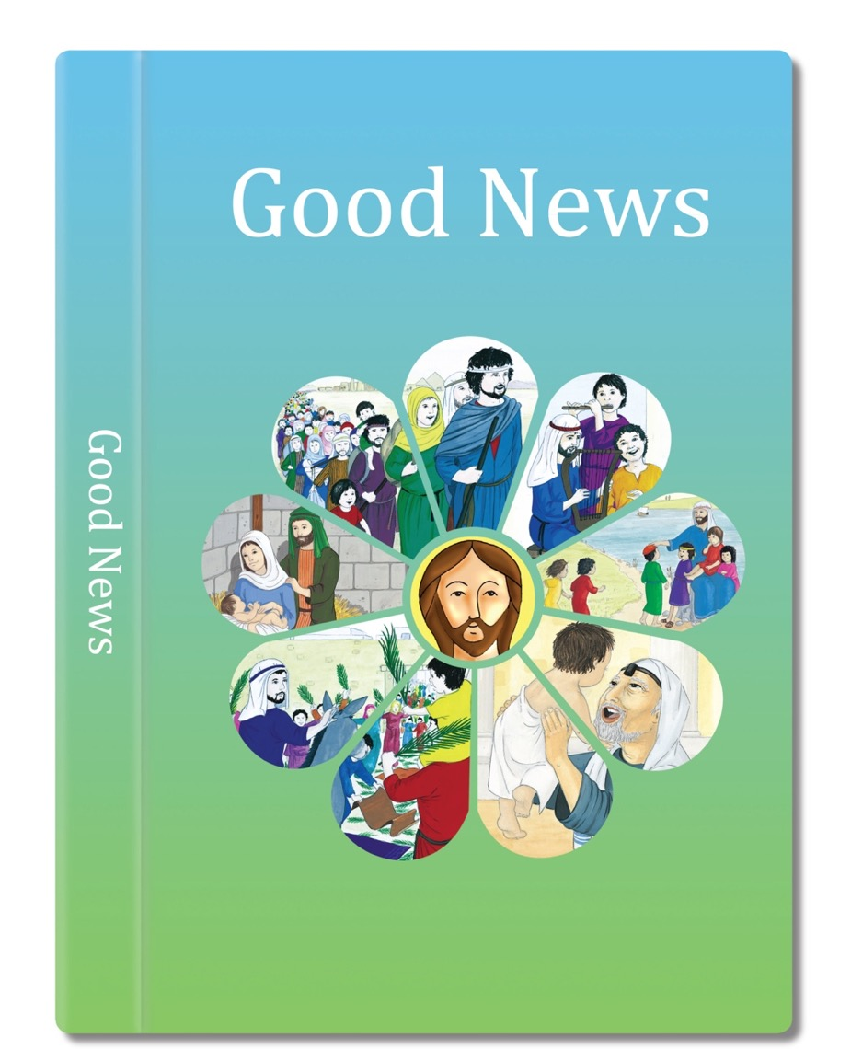
Let’s read the scripture to learn about rules that Jesus gave us.

Slide 14
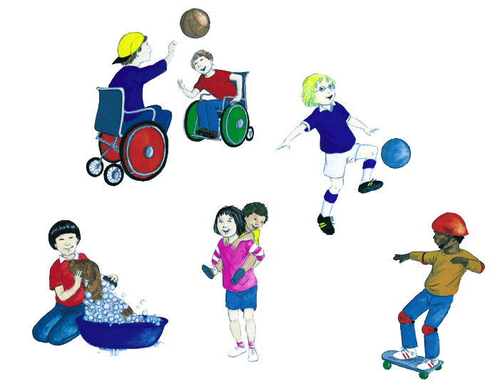
You are created by God, to be like God.
But the important thing is that you are God’s children.
You are God’s people, his saints. God loves you.
So love one another, help one another, be at peace with one another, and let the love of Jesus fill your hearts and minds.
You should be kind and gentle, and patient and forgiving, and loving like God.
You are all different.
You come from different places, speak in different ways, have different customs.
Based on Colossians 3: 10-17
(God’s Story 2)

Slide 15
SOME KEY QUESTIONS TO TALK ABOUT:
Which words do you like best and why?
Which things are hardest and why?
What does St Paul say is important?
How do you think you feel when you are at peace and when the love of Jesus fills your mind?

Slide 16
Show your learning…
Discuss the words ‘You are God’s people, his saints’. What do you think it means?
You can be one of God’s saints by doing good deeds.
Divide your page into 4 boxes. In each box draw and write how you can be God’s saint.
I am God’s saint when I share my toys.
I am God’s saint when I…
I am God’s saint when I…
I am God’s saint when I….

Slide 17
LEARNING FOCUS 2: Breaking rules.
LEARNING FOCUS 3: Being sorry and forgiving others.
I can recognise some religious words and signs that Christians use to express sorrow and forgiveness.
I wonder how
have I been
God’s saint this week?

Slide 18
Think back over the last session about the work that was done about living in peace and harmony with ourselves and one another.
Sometimes there are occasions when we purposely break important rules about loving. When something bad is done on purpose, that we know will upset or hurt someone, that is called a ‘sin’. When we purposely don’t do something that we know we should do and know that it will hurt or upset someone that, too, is a sin.
A sin breaks our friendship with God and others and makes us feel bad. When we sin, God still loves us, just as our parents love us even when they do not like what we do.

Slide 19
Chloe and Phoebe were sisters, Chloe was seven and Phoebe was three. Usually they were great friends, but one day Chloe was in a bad temper because mum had told her off for not letting Phoebe play with her toys.
‘Right’ thought Chloe, I’ll get my own back.’ so she got a felt tip and she wrote Phoebe’s name on the back door. ‘Aha,’ she thought, ‘now Phoebe will get into trouble’.

Slide 20
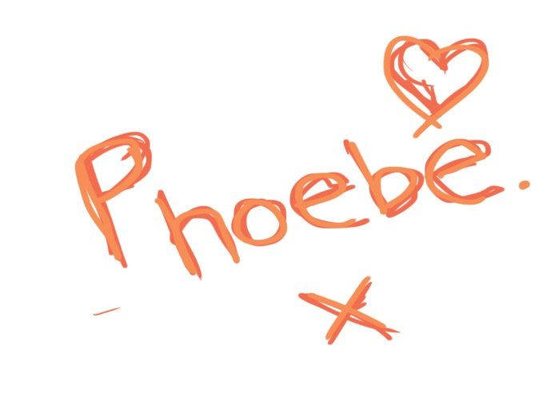
When mum saw it she was not very pleased and was about to call Phoebe, when she suddenly realised of course Phoebe was too young to write her name.
She knew who had done this. She still loved Chloe but was very disappointed that she had done something naughty.

Slide 21
SOME KEY QUESTIONS TO TALK ABOUT
What is the difference between doing things accidentally and doing them on purpose?
What happens when we sin, when we do bad things on purpose?
Do you think that Chloe’s action was a sin?
How do you think she felt?
How would you have felt if you had been Phoebe?
Why do you think Chloe’s Mum loved her in spite of what she had done?

Slide 22
Draw or write good and bad choices in the circle.
Can you think of any choices which could go in the middle?
Good Choice
Bad choice
Ideas: Sharing my toys Shouting and crying when I don’t get what I want Tidying away my toys Leaving someone out of my game

Slide 23
Let’s reflect…
Let’s think about the story again…..
What do you think Chloe should say to her mother and to Phoebe.
What do they think her Mum might say?
There are always consequences to wrong choices. What do you think were the consequences of Chloe’s actions?
Can you think of times when they have had to say sorry and how they felt.
What happens when someone says sorry to you?
What ways can you think of for making a new start.
What do you need to do if you have upset or hurt someone?

Slide 24
We need to recognise and admit that when we have upset and hurt someone.
We need to be sorry and say sorry to them. We also need to make up in some ways for the hurt we have caused.
Sometimes it is hard to forgive, but that is important too. We all have times when we want to be forgiven.

Slide 25
Show your learning…
Write a ‘sorry’ prayer beginning:
Dear God I am sorry for…..
Amen

Slide 27
LEARNING FOCUS 4: Jesus teaches his disciples about forgiving.
I can recognise that people say sorry and ask forgiveness because they are followers of Jesus.
Think about what we leant
about being sorry...

Slide 28
The friends of Jesus asked him about forgiving people who had hurt them.
Peter thought it would be good to forgive them seven times and that would be quite hard to do.
Peter was surprised when Jesus told him that you have to keep on forgiving, but he did say that the person who had done wrong should say sorry and really mean it.

Slide 29
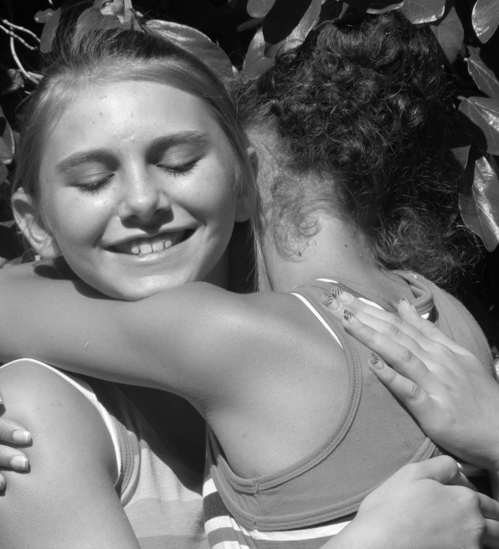
Peter came to Jesus and asked,
“If my friend keeps hurting me, how many times do I have to forgive him? Seven times?”
“No, not seven times,” answered Jesus, “but seventy times seven.”
Based on Matthew 18: 21-22
God’s Story 2

Slide 30
SOME KEY QUESTIONS TO TALK ABOUT
How do you think Peter felt when he heard what Jesus had to say?
How do you make up with others after something has gone wrong?
How do you feel when you realise you have to keep forgiving?
Teaching Point
Seventy times seven is a way of saying always.

Slide 31
Show your learning…
Make a path of ‘stepping stones’ – you could use paper, card, paper plates or anything you have to hand.
Put a sign that says ‘Forgiveness’ at one end.
The child should take a journey along the ‘path of forgiveness’ and as they step on each ‘stone’ they say a word about friendship and forgiveness.

Slide 32
LEARNING FOCUS 5: The Sacrament of Reconciliation.
I can use religious words and phrases to describe the examination of conscience. I can describe some aspects of the Sacrament of Reconciliation.
it is a good idea at the end of each day, to think over what has happened during the day, to thank God for all the good and lovely things that have happened and to remember if there have been times when we have not been very kind or loving. Adults call this an examination of conscience. Your conscience is the sense of right and wrong that is inside you and helps you to follow God’s rules.

Slide 33
There is a Sacrament, a sign of God’s love, that helps Catholics, to examine or look at their consciences and ask for God’s forgiveness. It is called the Sacrament of Reconciliation. You think of the sins you are sorry about, the things you have done wrong on purpose. You ask God to forgive you, and tell the priest, who won’t tell anyone else. The priest tells you your sins are forgiven in Jesus’ name and asks you to make up for them by being kind or by saying a prayer.

Slide 34
Show your learning…
What is the priest saying?
What do you think the boy is saying?
Role play or write speech bubbles for what the boy and priest are saying.
Remember to use religious words!

Slide 35
LEARNING FOCUS 6: Sign of peace
I can describe how Christians try to practice Jesus’ commandment of love, peace and reconciliation.
What does ‘reconciliation’ mean?

Slide 36
Let’s read about Jesus’ rule for us.

Slide 37
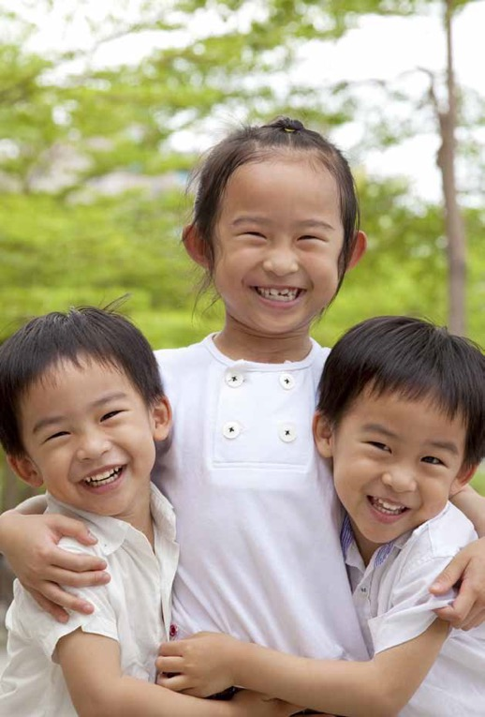
‘My commandment is this;
Love one another, just as I love you.’
Based on John 15: 12
(Come and See)

Slide 38
SOME KEY QUESTIONS TO TALK ABOUT
What do you think Jesus’ rule means in our daily life?
How did Jesus show his love for all the people he met?
What would the world be like if we all kept that rule?

Slide 39
When people go to Mass, just after they have all said the Our Father prayer, they give each other a Sign of Peace to show they follow Jesus’ rule by wanting to be friends with one another and prepare for Holy Communion.
During a community celebration of Reconciliation, we also offer each other a Sign of Peace to show that we are forgiven and that we want to live in love and peace with each other.
Why do people give each other a Sign of Peace?

Slide 40
Show your learning…
https://www.youtube.com/watch?v=41FZZygGWdU
Sing the hymn ‘A new commandment’ (link above) and think about the words.
Create a poster or mindmap to show the meaning of the song – include ideas of peace, love and reconciliation.

Slide 41
RESPOND
Remembering, celebrating and responding to how rules can help at home and in school and the reasons for rules in the Christian family
Remember
Start the session with a moment of quiet reflection. Light a candle and make the sign of the cross. Provide your child with the opportunity to engage with questions of meaning and purpose related to the experience of Rules.
Ask your child if there is anything they wonder about
The importance for themselves and for others of keeping rules.
How rules are necessary in life.
How it is sometimes hard to say sorry.
How it is sometimes hard to forgive others.
The good feeling when people make up.
Provide the opportunity for your child to remember
What Jesus told Peter about forgiving others.
What Paul had to say to the Colossians about being saints.
What a sin is, the difference between doing something accidentally and on purpose.
The importance and helpfulness of examining your conscience every day.
A sorry prayer.
Something of the Sacrament of Reconciliation.
The Sign of Peace.

Slide 42
Rejoice
Sing the hymn ‘A new commandment’ again together.
Apply their learning
Which rule will I keep today?
Some suggested ideas
After a time of quiet reflection and prayer
Make a friendship card or bracelet for someone they don’t usually play with.
Make a card or another symbol to put on their pillow to remind them when they go to bed to think about their day and how they have lived by the rule of love. What they are glad or sorry about.
Make an “I love you” card to give to your parents/carer.

