Slide 2
Learning Objectives
Be able to calculate unknown angles around a point

Slide 3
A Full Turn
A full turn is when a line turns around in a complete circle.
It measures 360°
360˚

Slide 4
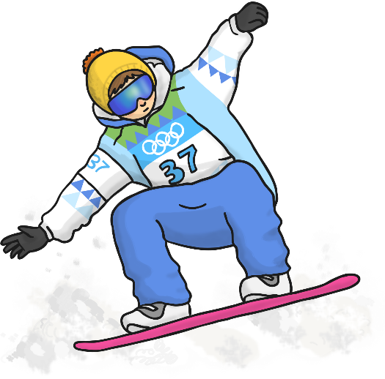
A snowboarder attempts a 360˚ spin but doesn’t quite make it. How many degrees has he missed the turn by?
360º – 300º = 60º
300˚

Slide 5
A snowboarder attempts a 360˚ spin but doesn’t quite make it. How many degrees has he missed the turn by?
360º – 210º = 150º
210˚

Slide 6
A snowboarder attempts a 360˚ spin but doesn’t quite make it. How many degrees has he missed the turn by?
360º – 170º = 190º
170˚

Slide 7
Work out the unknown angle
We know there are 360º around a point (a full turn)
We need to calculate m
We can do 360º – 130º – 70º = 200º
Or find the total of the angles we know and use this to find the missing angles
130º+70º = 200º
m = 360 -200 = 160º

